Slide 1
Preservation of Affordable Housing (POAH) RAD/PRAC Preservation Transaction Preview

Slide 2
Acquisition Overview
4 202/PRAC properties
240 total units
60 units in each property
Built YEARS
2 completed in 2007
2 completed in 2004
Map or Building Image
Current

Slide 3
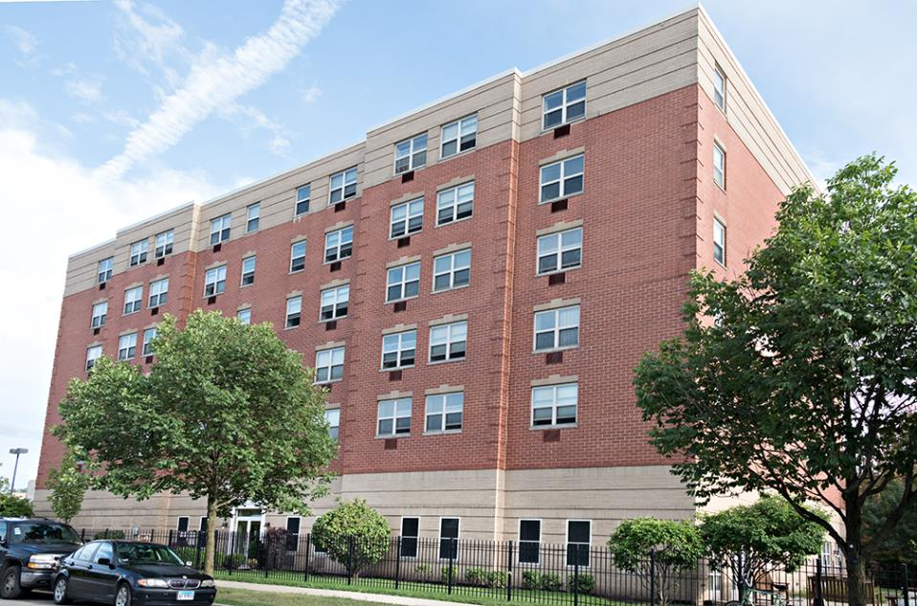
Seller’s Perspective
Preservation Intent
Proceeds Issues (“housing uses”)
RAD Equity Calculation
Acquisition Approach

Slide 4
Rent Setting
1BR gross rents $1,093-1211
Avg. 106% of FMR
Proposing expense reduction to support new debt:
All US PRAC units – by % of FMR
Current
Above 121% FMR
8%
Per unit operations: | Current (2019) | Stable Year (2022)
Gross Rent | $ 14,004 | $ 14,861
Income | $ 13,584 | $ 14,415
Opex | $ 12,400 | $ 11,500
Reserves | $ 1,075 | $ 400
NOI | $ - | $ 2,515
Debt Service |  | $ 1,935
Cash Flow | $ 109 | $ 580
Supportable Debt | $ - | $ 30,256

Slide 5
Transaction Overview
Sources | Per Unit |  | Uses | Per Unit
First Mortgage | $ 30,000 |  | Acquisition | $ 125,000
4% LIHTC Equity | $ 52,000 |  | Payoff POAH Acq/Hold Loan | $ 15,000
FHLB Loan | $ 7,500 |  | Assume FHLB Loan | $ 7,500
Seller Note | $ 102,500 |  | Seller Note | $ 102,500
Existing Reserves | $ 14,000 |  | Construction | $ 40,000
CF from Ops | $ 1,000 |  | Soft Costs | $ 17,000
Deferred Fee | $ 13,000 |  | Reserves | $ 12,000
 |  |  | Paid Fee | $ 13,000
 |  |  | Deferred Fee | $ 13,000
Total Sources | $ 220,000 |  | Total Uses | $ 220,000
Current

Slide 6
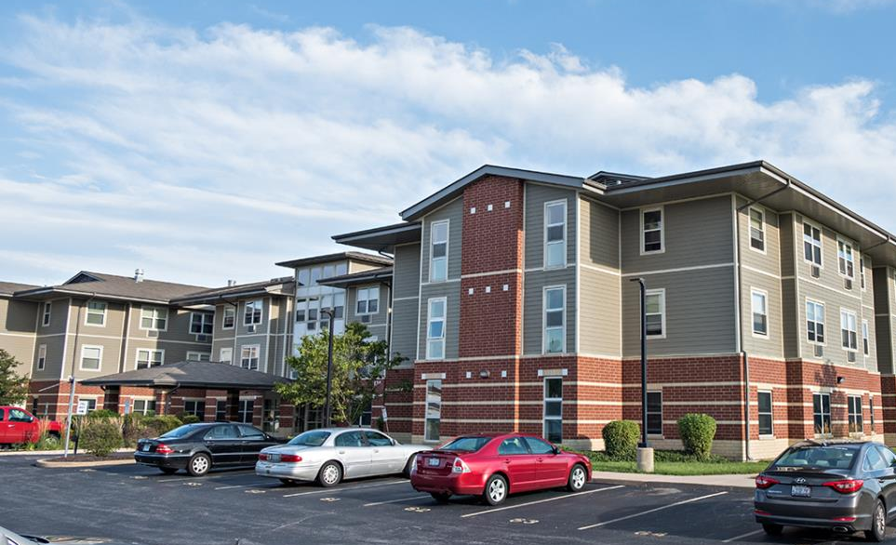
Questions / Issues
Rent increase process post-freeze? / CR anomaly fix?
TPA cap needs standards for prospective PRAC conversions?
Seller equity/proceeds issues on prospective PRAC conversions
Others?

