Slide 1
Conversion of Section 202 PRACs under the Rental Assistance Demonstration (RAD)
October 7, 2019

Slide 2
Background

Slide 3
Section 202 Background
Three Chapters of the Section 202 Program
Pre-1974 Section 202 Direct Loan
Section 202 Direct Loans with Section 8 contracts (“202/8s”)
Section 202 “Capital Advance” properties with Project Rental Assistance Contracts (202 PRACs)
2,800 properties (120,000 assisted units) placed in service since 1993

Slide 4
Why RAD for Section 202 PRACs?
RAD was designed to preserve and recapitalize an aging stock of HUD-assisted housing by allowing properties to convert to long-term, Section 8 rental assistance contracts, which:
Allows owners to access debt and equity to finance capital needs
Provides a strong platform for long-term preservation
RAD ensures long-term housing for the elderly and applies a robust package of resident rights
Congress authorized the conversion of 202 PRACs under RAD in the FY 2018 Appropriations Act
4

Slide 5
RAD Notice
Housing 2019-09/PIH 2019-23 (“RAD Notice Rev 4”) published September 5, 2019
Four Sections
Public Housing conversions
Mod Rehab/SRO conversions
Rent Supplement and Rental Assistance Payment conversions
New! 202 Project Rental Assistance Contract (PRAC) conversions

Slide 6
Structure of RAD
RAD for Public Housing also known as the “1st Component”
RAD for Other Multifamily Housing also known as the “2nd Component”
Public Housing
Rental Assistance Payment
Sec. 8 Moderate Rehabilitation
Rent Supplement
Sec. 202 PRAC
McKinney Vento SRO
RAD
Conversion
Section 8 PBRA
Section 8 PBV

Slide 7
Owner Objectives
Owners can use RAD to:
Modernize aging elderly properties
Stabilize property revenue
Rehab deteriorated properties
Transfer assistance to better neighborhoods
Thin densities and mix-incomes
7

Slide 8
Section 202 PRAC Portfolio

Slide 9
202 PRAC-Assisted Boston Satellite Universe
267 assets with 202-PRACS in Satellite (9,356 Units)
CT: 51 Assets 1,890 Units
MA: 105 Assets 3,856 Units
ME: 27 Assets 743 Units
NH: 39 Assets 1,194 Units
RI: 34 Assets 1,336 Units
VT: 12 Assets 337 Units
9

Slide 10
Age of PRAC Properties
10

Slide 11
Rents and Replacement Reserves
11

Slide 12
202-PRAC BBRI Guidance
July 17, 2019 OAMPO Memorandum
Applies to Pending & Future 202 PRAC Renewals
R4R Deposits to Remain at Current Levels
Properties with CNAs demonstrating capital needs may resubmit in FY20
Proposed BBRI where Gross Rent exceeds 5% must be submitted through Financial Operations Branch
Update expected October 2019, effective until further notice.
12

Slide 13
Pre-RAD Application BBRIs
In accordance with:
HUD Handbook 4350.1 Chapter 7
October 29, 2015 Memo Procedures for PRAC Renewals
Tenant notification
Cover Letter
Budget Worksheet
Basis for Expenditures
Description of Improvements (CNA)
Chapter 5 of MAP Guide
13

Slide 14
Budget Based Rent Increases
National Working Group:
HQ and Field Representation
Developing Internal SOWs
Designed to enhance consistency between offices, regions reviewing submissions
Budget Based Rent Increases
CNA Review
Memo from DAS informing industry on updated policies release imminent
14

Slide 15
Pre-Application Technical Assistance
Field RAD Team (Field innovation)
202 Preservation Expert
LIHTC Expert
PIH Strategies Expert
Physical and Financial Recapitalization Expert
Provides Technical Assistance with positioning your asset for recapitalization, including RAD
15

Slide 16
Program Requirements
16

Slide 17
Contracts and Rents
Rents based on PRAC rents, which may be adjusted prior to conversion based on budget (e.g., justified by capital needs assessment or service coordinator salary)
20-year renewable contract
Annual rent adjustment by operating cost adjustment factor (OCAF)
No limitation on use of project cash flow
RAD Elderly Housing Use Agreement replaces the Capital Advance Use Agreement and adds 20 years of required affordability
HAP contract must be renewed throughout the term of the Use Agreement
17

Slide 18
Comparison of Contract Types
Contract Type | Project Based Rental Assistance (PBRA) | Project Based Voucher (PBV)
Contract Administration | Performed by HUD | Performed by Public Housing Agency (PHA)
Contract Start | First of month at least 30 days after “closing” | Must align with PRAC anniversary date and be at least 90 days from “closing” date
Inspections | UPCS performed by REAC starting after any required work is completed | HQS performed by PHA
Rent Setting | Based on PRAC Rents, not to exceed 120% of FMR or Small Area FMR | Based on PRAC Rents, not to exceed 110% of FMR or Small Area FMR
18

Slide 19
Potential RAD Financing Sources
First Mortgage Debt
FHA-Insured Debt
223(f) for light or moderate rehab
221(d)(4) for substantial rehab or new construction
Conventional Debt
Equity
4% LIHTC
9% LIHTC
Historic Tax Credits
State Tax Credits
Depreciation/Losses
Other (NMTC, OZ, energy)
Other Financing
HOME
CDBG
Housing Trust Fund
Federal Home Loan Bank AHP
State and local funds
Existing “Residual Receipts” or replacement reserves
19

Slide 20
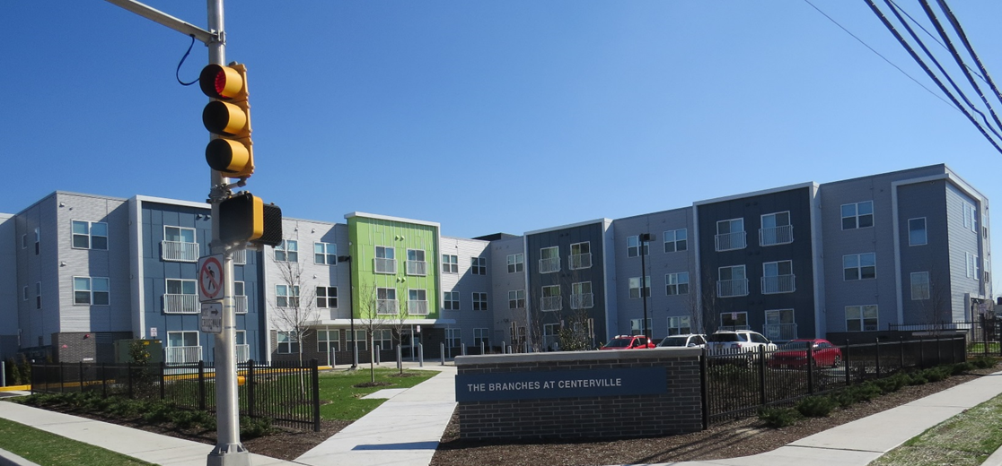
Transfer of Assistance
Transfer of assistance refers to a change in the geographic site of the assistance. It has the potential to improve the location and quality of housing
HUD will assess:
That the transfer does not place housing in neighborhoods with highly concentrated poverty;
Whether conversion on-site is economically non-viable (physically obsolete or severely distressed)
The impact on residents
20

Slide 21
Conversion Requirements
Capital Needs Assessment
Identifies all immediate and long-term capital needs
Must be consistent with MAP Guide requirements (except eTool)
Conversion Plan must cover all needs through upfront capitalization (if applicable) and ongoing capital replacement reserve deposits
Must be consistent with CNA submitted for any recent BBRI
Environmental Review
Part 50 for PBRA or FHA-insured conversions. HUD performs the review in HEROS.
Part 58 for all other PBV conversions. Responsible Entity performs the review.
21

Slide 22
Conversion Requirements
Ownership and Control
Property must be owned or controlled by a non-profit entity (e.g. no change in ownership; transfer to another non-profit; or LIHTC entity controlled by a non-profit)
Ownership structures that facilitate LIHTC use are allowed (e.g. non-profit is GP in a limited partnership; majority owner in an LP or LLC; long-term ground lease, control agreement, etc.)
Refinancing Sales Proceeds
Net refinancing or sales proceeds, with certain allowable exclusions, during the remainder of the original Capital Advance term are restricted to Affordable Housing Purposes
22

Slide 23
Conversion Requirements
Davis-Bacon
Not applicable for rehab of previously assisted PRAC units
Operating Reserves
In lieu of residual receipt account, owner must establish and maintain an operating reserve account in an amount of $250 per unit to be used for project purposes (unexpected expenses, delinquent receivables, etc.) before taking any cash flow
No upfront requirement to capitalize the reserve
HUD approval is not required for withdrawal, but minimum balance is a condition of owner distributions of surplus cash
23

Slide 24
Conversion Requirements
Supportive Services for Residents
Owners must describe services plan in Conversion Plan and contractually commit to ongoing services
PRAC owners may already include a Service Coordinator and $15 PUM for services in their PRAC budget, which would be captured in the Section 8 rent at conversion
For properties converting through RAD, HUD may approve an increase in the project budget line item for service costs from $15 (the current maximum) up to $27 per unit per month, if warranted by services
24

Slide 25
Resident Rights and Requirements
Resident notices and resident meetings required prior to conversion
Prohibition of re-screening residents for Section 8 eligibility upon “move-in” to the property
If rehab requires any relocation, residents have a right to return post-rehab and may not be involuntarily displaced
Uniform Relocation Act (URA) applies to any relocation
25

Slide 26
Conversion Process
26

Slide 27
Getting Started
Owner uploads Submission of Interest on www.RADresource.net with basic project and owner information
HUD assigns a Transaction Manager
HUD is available for guidance to owners
Owner is governed by existing PRAC rules and asset management procedures until conversion
27

Slide 28
RAD Conversion Process
Initial Submission of Interest
Submitted on the RAD Resource Desk
Provides basic owner and property information
HUD assigns a Transaction Manager to work with the owner
Resident Notification and Consultation
Written notification of conversion proposal
At least 2 resident meetings with opportunities to comment
Conversion Plan
Submit detailed proposal after completion of the owner’s planning process
Demonstrate the physical and financial viability of the project
Demonstrate compliance with program requirements
RAD Approval
Approves the Conversion Plan
Sets out conditions to closing
Outlines terms of the conversion and required construction
Closing & Conversion
Execution of Conversion Agreement
Termination of PRAC and Capital Advance documentation
Entry into Section 8 HAP Contract & RAD Elderly Housing Use Agreement
Rehabilitation/ Construction
If applicable, work completed in accordance with Conversion Agreement
28

Slide 29
Post closing
29

Slide 30
Role of Boston Multifamily Housing Satellite Asset Management Staff
Outreach: Host and participate in informational sessions
Pre-Conversion Application: Technical assistance on recapitalization, financing resources, FHA loan products, pre-transaction items
Application Process: Tenant Meeting, Ongoing TA per HQ’s request (2530 Process, AFHMP Review, Lease Review, etc.)
Post-Conversion (PBV): PIH & LHA
Post-Conversion (PBRA): Contract Set-up, Monitoring, and Compliance, Technical Assistance
30

Slide 31
Post-Conversion Multifamily Housing Field Office
Asset Remains with
Multifamily Housing Account Executive
PRAC Contract is now a Section 8 Contract
HUD is still the Contract Administrator
Vouchering in TRACS
Continue to use AMPS (bos.incoming@hud.gov)
31

Slide 32
Post-Conversion Multifamily Housing Field Office
Contract Set-up:
Owner Submits Post-Approval PBRA Documents:
Owner Tax Identification Number (TIN)
Management Agent TIN and Management Certification
SF 1199 – Direct Deposit form, voided check and DUNS #
Building address information/type of buildings
Fiscal Year End of owner
32

Slide 33
Post-Conversion Multifamily Housing Field Office
Monitoring & Compliance
Physical Inspections (REAC)
Annual Financial Statement Review
Management & Occupancy Reviews (MOR)
Field MOR Team
Completed ~250 MORs on PRACS
Cycle Through ~2021
33

Slide 34
Post-Conversion Multifamily Housing Field Office
Assigned Account Executive in Boston Satellite
Routine Servicing
Annual Rent Increases (OCAF)
Technical Assistance on Issues
Tenant Safety
Tenant Disputes
Emergency Repairs
Reasonable Accommodation Requests
Physical and Financial Security of Asset
34

Slide 35
Thank You and Questions For more information visit www.hud.gov/rad Join the RAD LISTSERV for news and updates (link available at the bottom right of the www.hud.gov/rad webpage)
35

